Slide 1



SILVER LEARNING
TRAINING SERIES

Slide 2

ABOUT SILVER LEARNING
What started as a small and simple clinic right at the heart of the metropolitan, grew into a larger scale operation that quickly gained popularity amongst people that go around the hustle and bustle of the metro. With our hospital established right where the people are all the time, we are able to cater to everyone better, and they can reach us better because we are very easy
and convenient to go to. We are able to treat minor ailments quickly without disrupting your daily schedule. We can cater to major illnesses and diseases as well as provide rehabilitation for those who are and have been previously injured. We have state of the art instruments for healing, and we always try to stay up-to-date with the latest medical trends in the market.

Slide 3


VISION
We envision that our patients, partners, and shareholders only receive the best treatments we have right now on the market. We are a hospital for the people which means we do not choose nor discriminate who we will be treating. Our hospital is a place where people can rest, visit, and be treated right and respectfully, without any hassle of them having to think twice about the price they have to pay.

Slide 4

MISSION
facilities are up-to-date, they eat well and be well right in our hospital. We firmly believe that every patient is of utmost importance. Our hospital is a place where people can rest, visit, and be treated right and respectfully, without any hassle of them having to think twice about the price they have to pay. We can cater to major illnesses and diseases as well as provide rehabilitation for those who are and have been previously injured. We have state of the art instruments for healing, and we always try to stay up-to-date with the latest medical trends in the market.
It is our mission to serve you well.
It is our mission to give our patients, partners, and shareholders the best treatment possible and available in the market. They can fully entrust to us their loved ones and of course, themselves, without having to worry about the price they have to pay because we can assure them that we only serve and give them the best, which they can immediately feel and see because our

Slide 5

GOALS
Our facilities are up-to-date, they eat well and be well right in our hospital. We firmly believe that every patient is of utmost importance. Our hospital is a place where people can rest, visit, and be treated right and respectfully, without any hassle of them having to think twice about the price they have to pay. We can cater to major illnesses and diseases as well as provide rehabilitation for those who are and have been previously injured. We have state of the art instruments for healing, and we always try to stay up-to-date with the latest medical trends in the market.

Slide 6
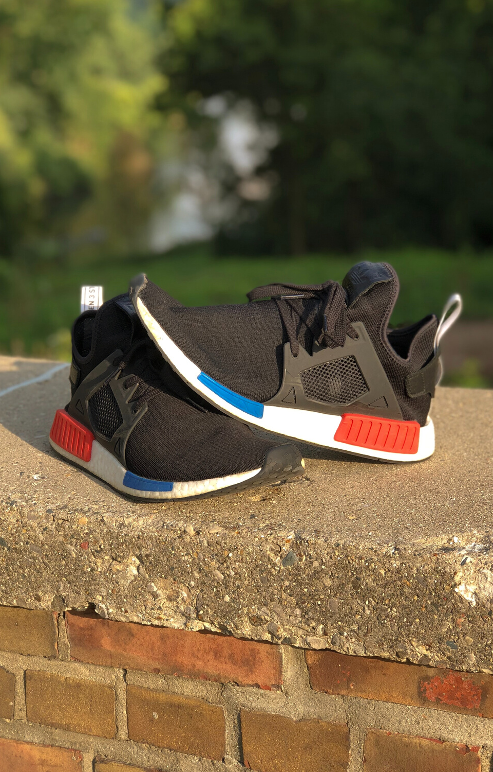
You can trust us to meet your needs right here in the metro.

Slide 7
SERVICES
EFFECTIVE MEDICINE
QUICK DIAGNOSIS
We only offer the best treatment in the market, and we can assure you that we only give you what works best for you.
In our state-of-the-art facility, we can offer quick and highly accurate diagnosis because you deserve to know right away.
QUICK CARE
QUALITY SERVICE
We meet your needs right away. Whether you are a visiting patient or an in-house patient, we make sure to treat you right away.
We make sure you only get the best, from the best. We only get doctors, nurses, and specialists that are experts in their field.

Slide 8
98%
Our customer satisfaction has increased to 98% since 2012, and upon implementing our new heart care system to all our patients and partners.
OUR STATS
99%
Our patient rating increased to 99% since we have implemented our Family Protection program that enables patients and partners to secure their loved ones' futures with us.

Slide 9


95%
ACCESIBILITY
People who live in the Metro now have access to a hospital where they can be assured that they can get quality treatment and service without worrying about the cost it will entail, for we cater specifically to them, without sacrificing quality of service.

Slide 10

+
THANK YOU!
YOUR HEALTH IS OUR PRIORITY.

